Slide 1
DIY Electronics: The Game of Simon using the Arudino
Ryan Brock

Slide 2
About Me
Ryan Brock
Software Engineer – 14 Years
Purdue University – Computer Science
Motorola
Zebra Technologies

Slide 3
Contact
Twitter: @borq79
Email: borq79@gmail.com
Github Repo:
https://github.com/borq79/Cary-Area-Public-Library-Classes

Slide 4
Agenda
Intro (5 Minutes)
Quick Basics (15 Minutes)
Buttons and Pullup Resistors
Piezo
WS2811
Game Time!

Slide 5

The Arduino Uno

Slide 6
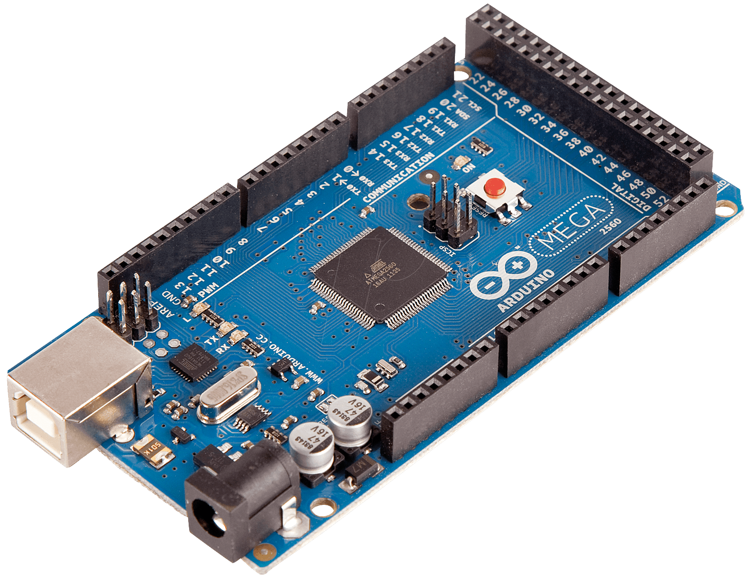
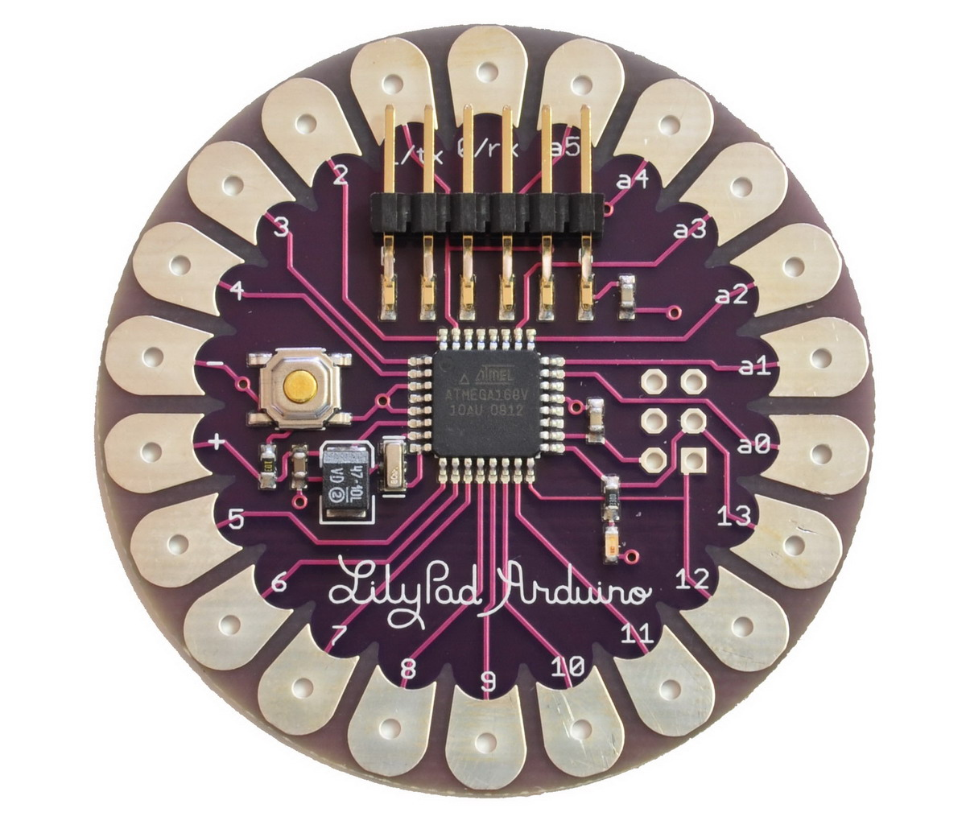
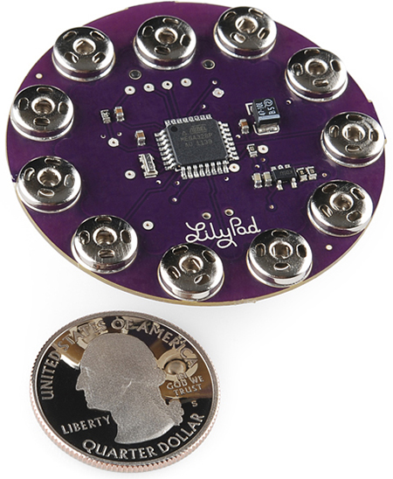
The Arduino Family

Slide 7
Your Kits
$55 Vilros Ultimate Starter Kit
https://www.vilros.com/ultimate-starter-kit.html
$8 LED Strip
http://www.amazon.com/NulSom-NeoPixel-Rainbow-Stick-Arduino/dp/B00PTEP14W/ref=sr_1_1?ie=UTF8&qid=1452991973&sr=8-1&keywords=neopixel+stick
$3 20 pc. Capacitor Pack
http://www.dx.com/p/16v-1000uf-aluminum-motherboard-capacitors-20-piece-pack-127865#.V0IQv5MrJMM
50 Button Pack
https://www.amazon.com/gp/product/B00R17XUFC/ref=oh_aui_search_detailpage?ie=UTF8&psc=1

Slide 8
Breadboard
Where is C:19?

Slide 9

Just Like Battleship

Slide 10
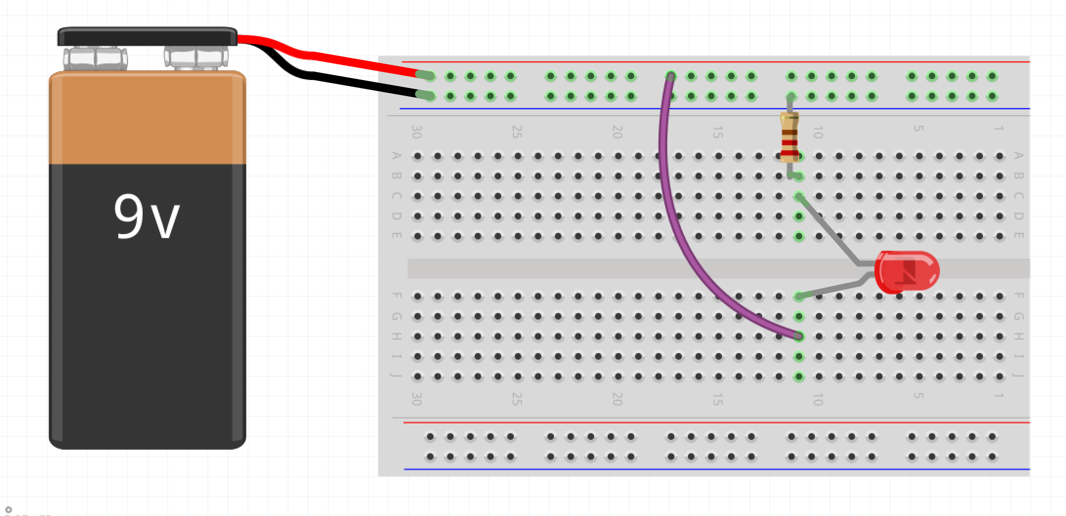
Wiring up a Circuit

Slide 11
Project Parts List
Arduino
Breadboard
USB Cable
1 Neo Pixel Strip with 8 LEDs
1 1000F Capacitor
1 10K Ohm resistor
3 Male-Female wires
12 Short Male-Male wires
4 small buttons (not the bigger ones)
1 Piezo Speaker

Slide 12
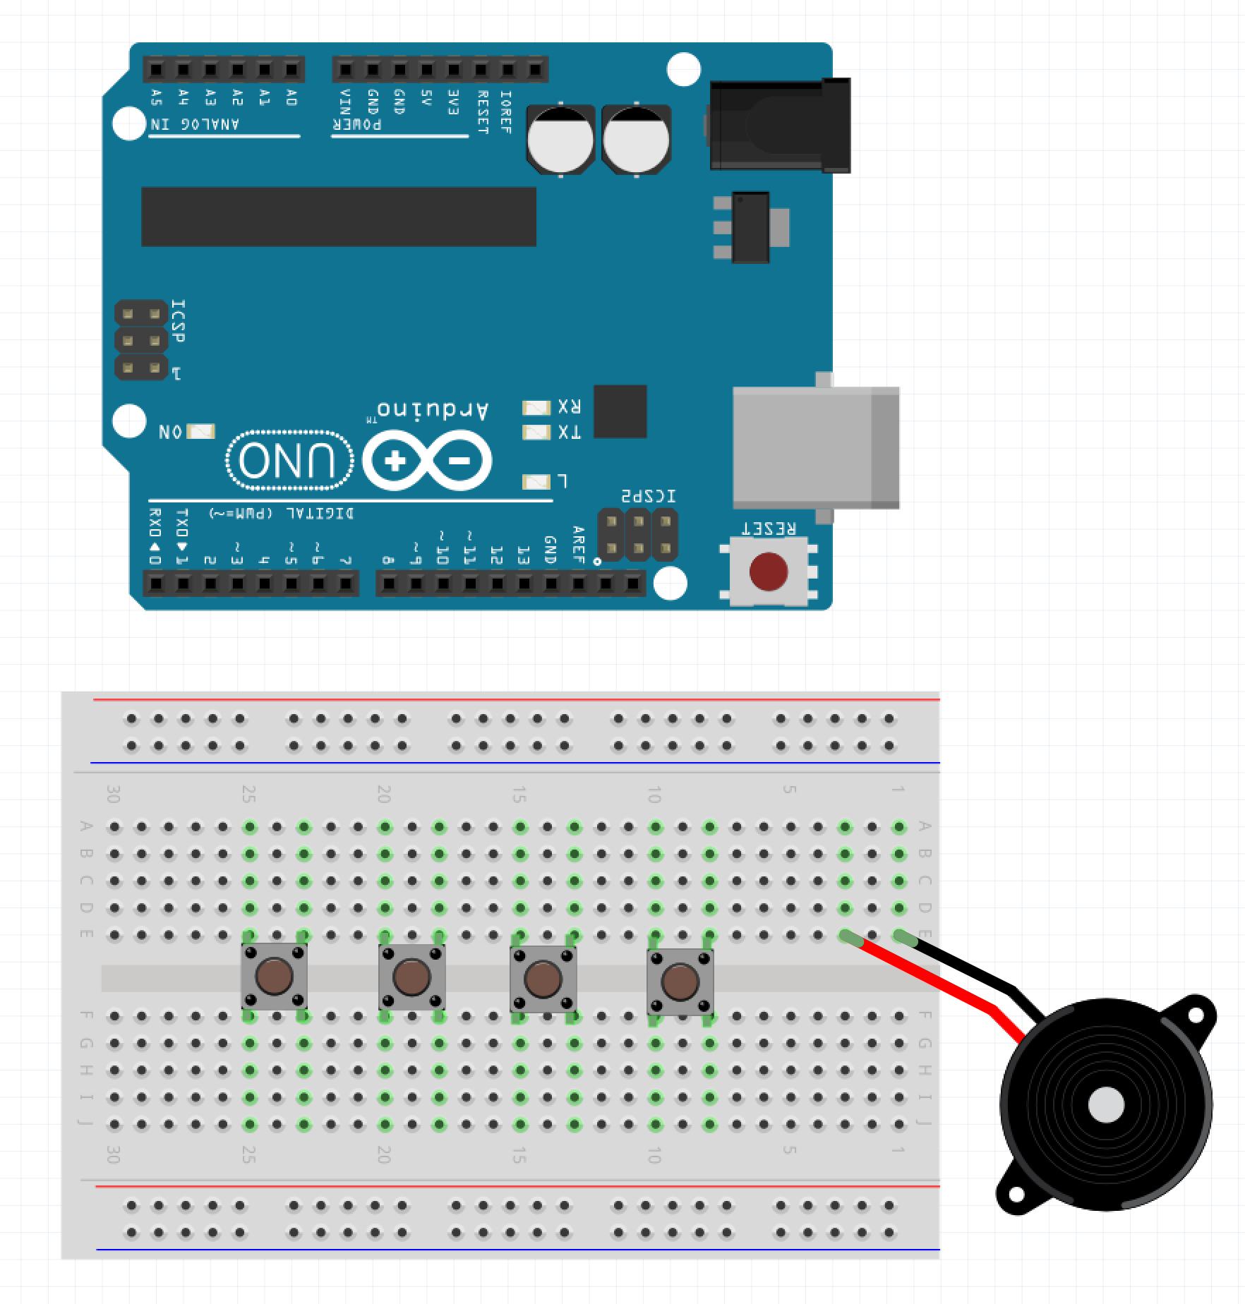
Step 1 – Place the Buttons and Speaker
Make sure the USB Cable is not plugged into the PC
Place the four buttons – Place the upper left corners in E:25, E:20, E:15, and E:10
Place the Piezo so that the + is in E:3 and the – is in E:1 (the piezo you have will not look like the diagram – it will sit directly on the board)

Slide 13
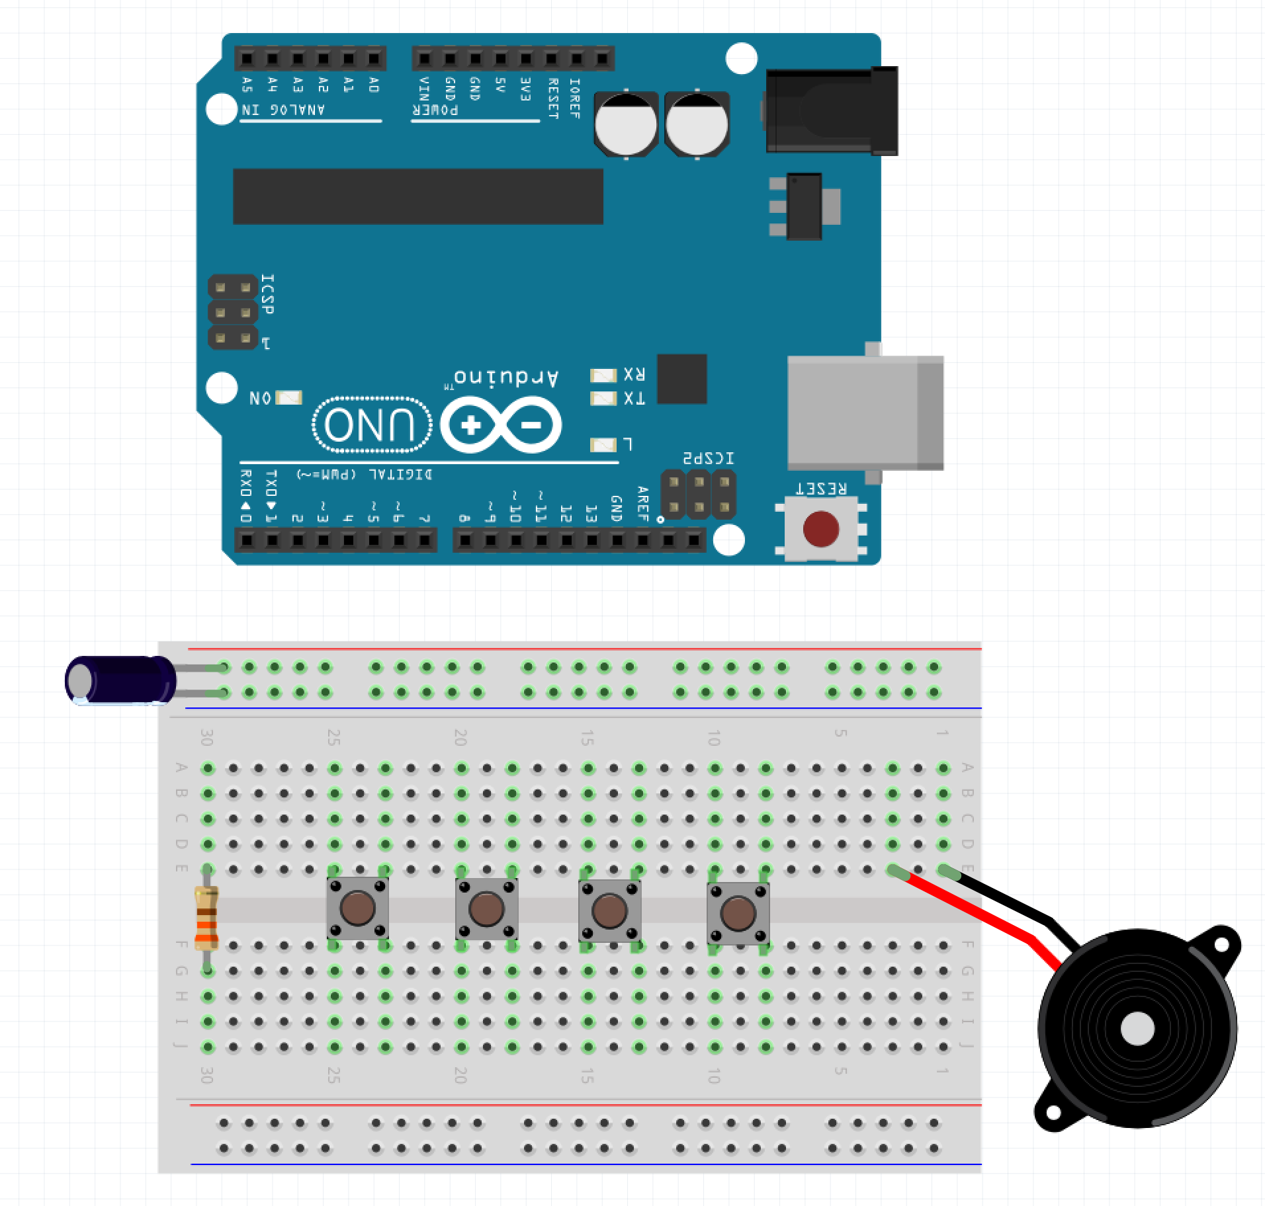
Step 2 – Place WS2811 Components
Place the + (longer leg) of the capacitor into the top red row
Place the shorter leg of the capacitor (also the side painted gray) in the top blue row
Place the one leg of the resistor in E:30 and the other leg into F:30

Slide 14
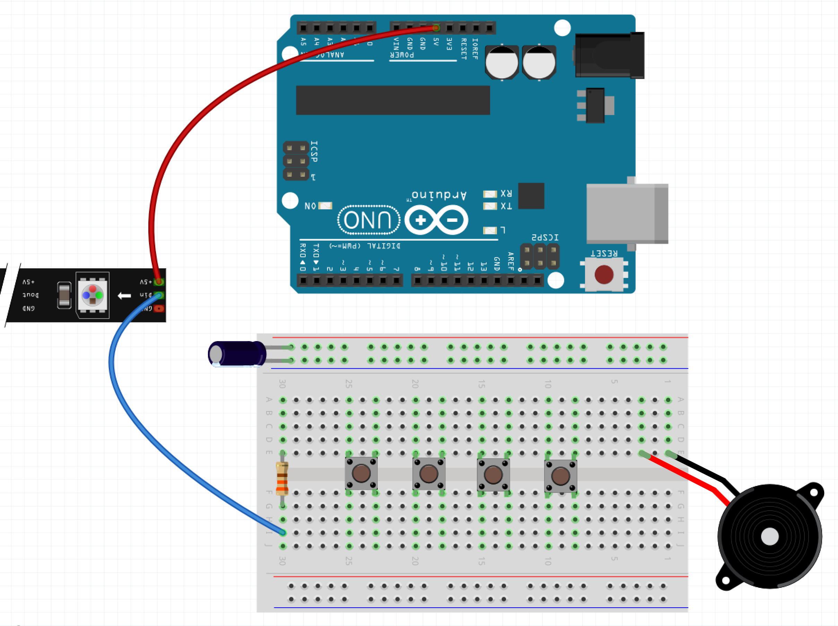
Step 3 – Start to Wire Up WS2811
Attach the female end of a female-male wire onto the 5V pin of the WS2811 – attach the male end into the 5V of the Arduino
Attach the female end of a female-male wire onto the DIn pin of the WS2811 – attach the male end into the I:30 of the Breadboard

Slide 15
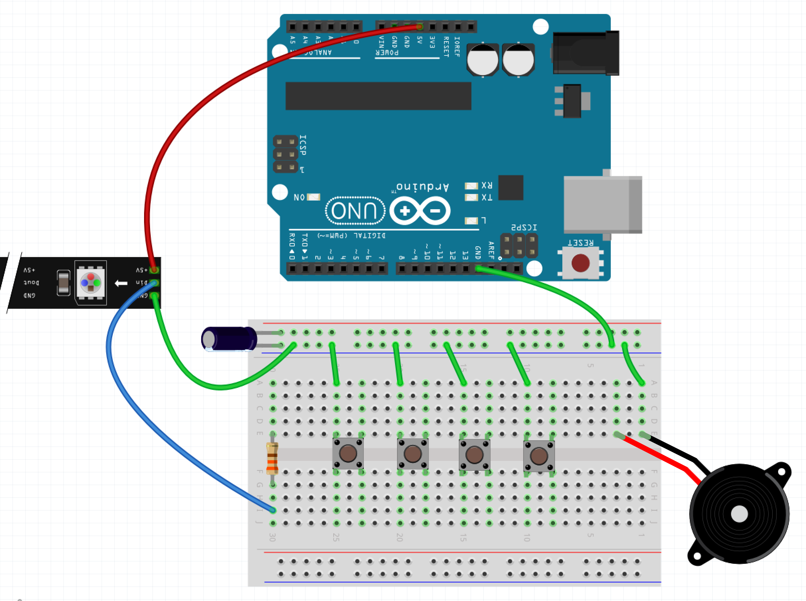
Step 4 – Run the Ground Wires
Run a wire from GND on the lower row of the Arduino to anywhere in the top blue row
Attach the female end of a female-male wire onto the GND pin of the WS2811 – place the male end into anywhere on the top blue row
Run 5 wires from anywhere on the top blue row to A:25, A:20, A:15, A:10, and A:1

Slide 16
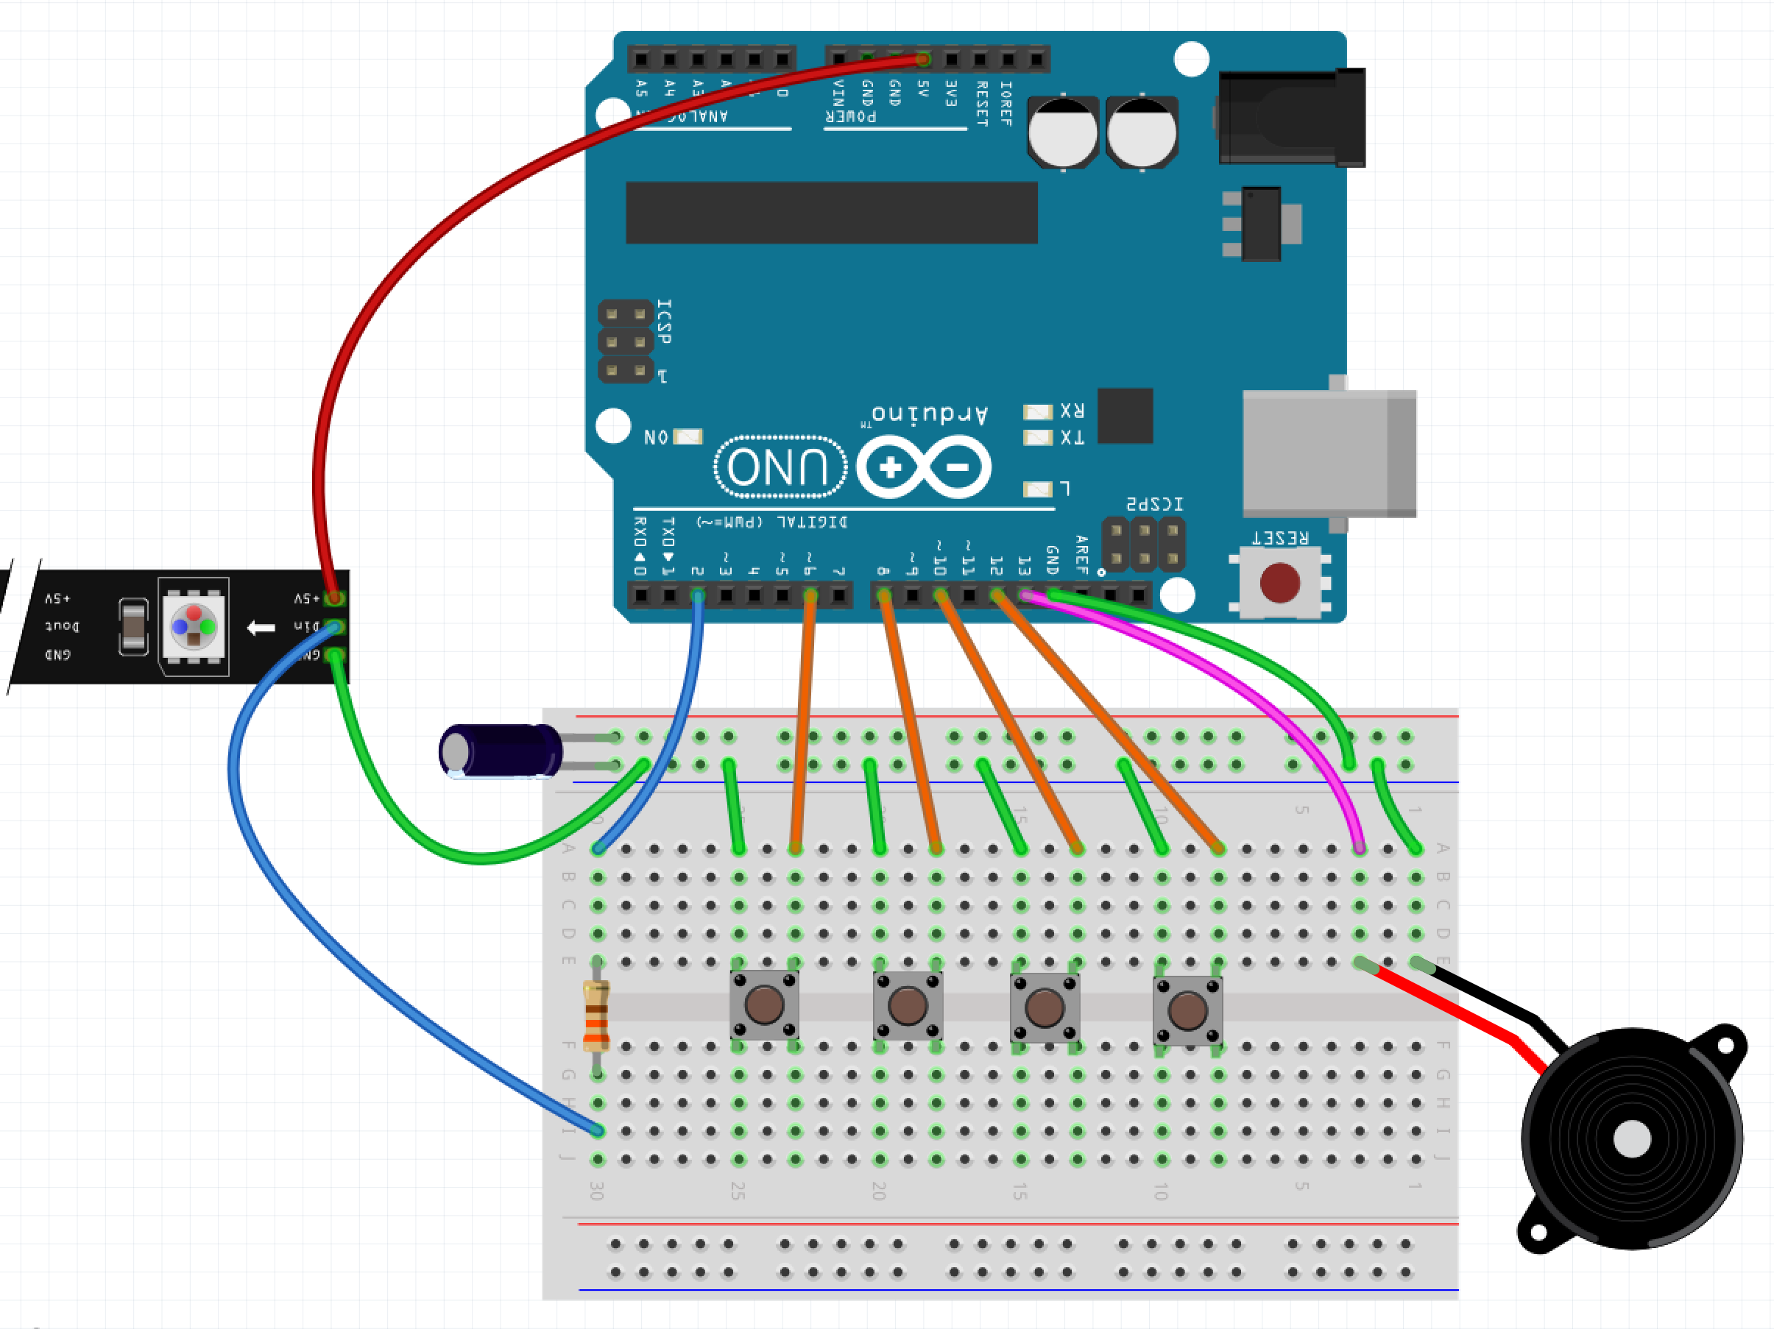
Step 5 – Run the Data Lines
Run a wire from pin 2 on the Arduino to A:30 (blue wire in diagram)
Run a wire from pin 6 on the Arduino to A:23 (orange wire in diagram)
Run a wire from pin 8 on the Arduino to A:18 (orange wire in diagram)
Run a wire from pin 10 on the Arduino to A:13 (orange wire in diagram)
Run a wire from pin 12 on the Arduino to A:8 (orange wire in diagram)
Run a wire from pin 13 on the Arduino to A:3 (magenta wire in diagram)

Slide 17
Step 5 – Program the Arduino
Plug the Arduino into the USB Cable
Plug the USB Cable into the PC

Slide 18
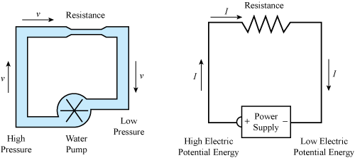
Water Analogy

Slide 19
LEDs

Slide 20
Why is one lead longer?

Slide 21
Project 2 Parts List
Arduino
Breadboard
USB Cable
1 330 Ohm resistor
1 LED
4 male-male wires
1 small button (not the bigger one)

Slide 22
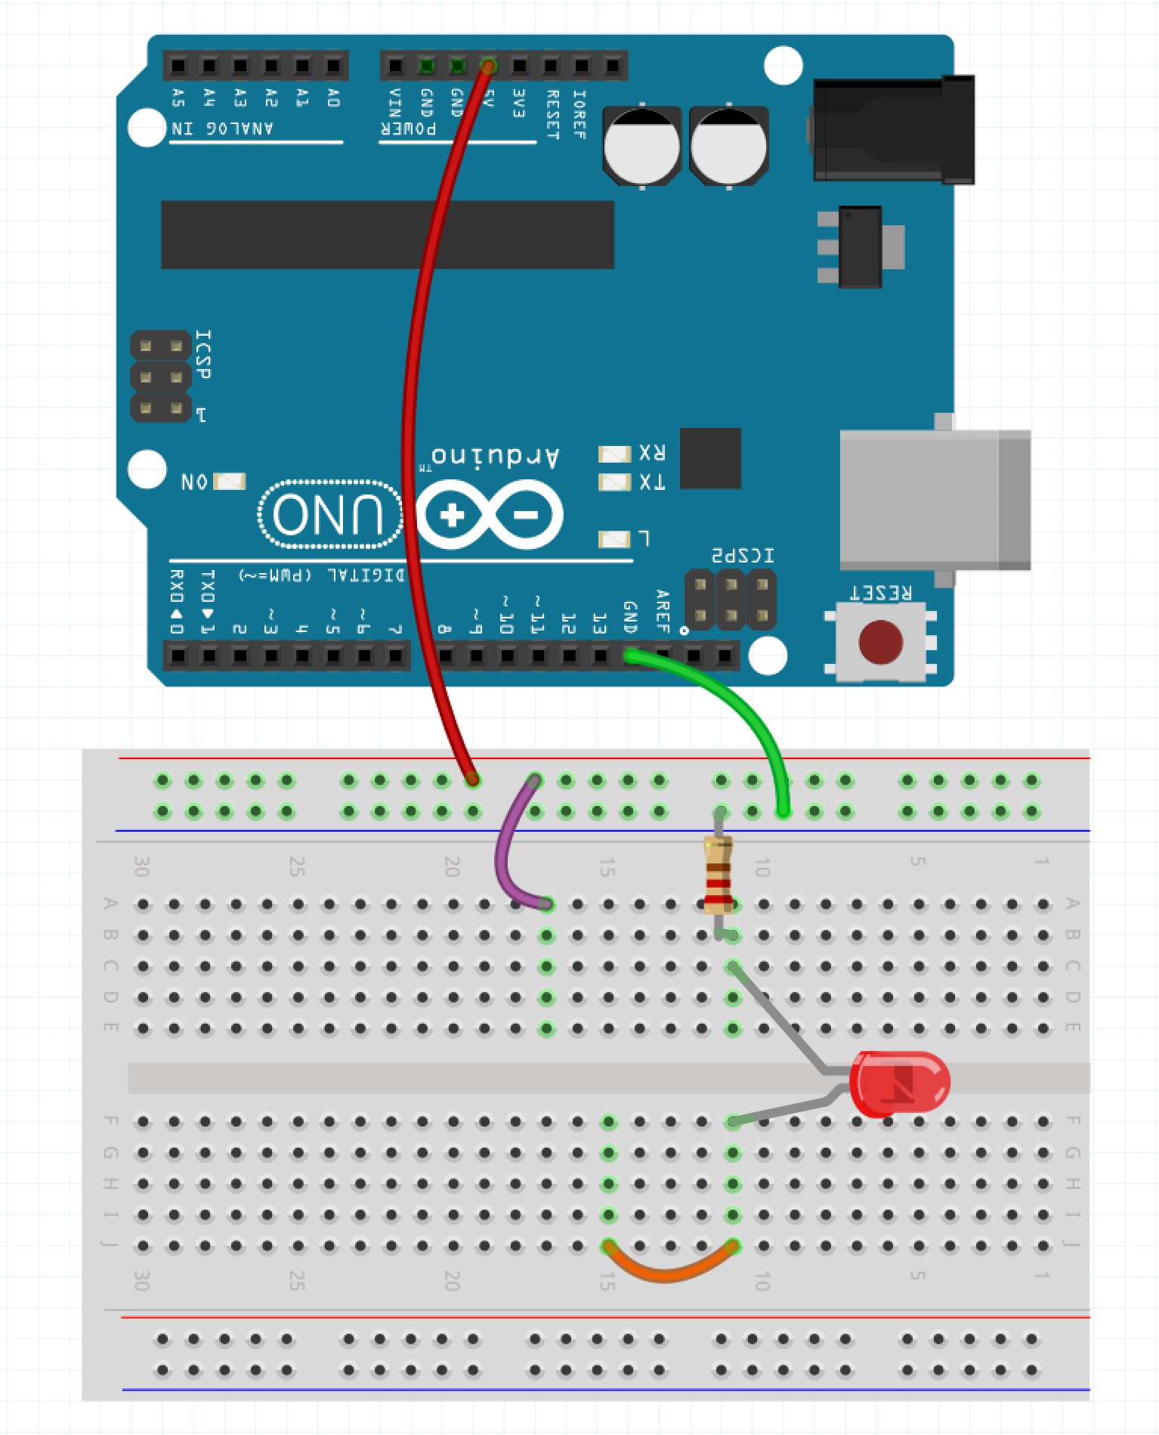
Step 1 – Move the Wires
Make sure the USB Cable is not plugged into the PC
Move the wire plugged into the red row from H:11 on the breadboard to A:17 (purple wire in the example)
Add a wire that jumps from J:15 to J:11 (orange wire in example)

Slide 23

Step 2 – Place the Button
Place the button across the gap so that the pins are in E:17, E:15, F:17, and F:15

Slide 24
Step 3 – Apply Power
Plug the Arduino into the USB Cable
Plug the USB Cable into the PC

Slide 25
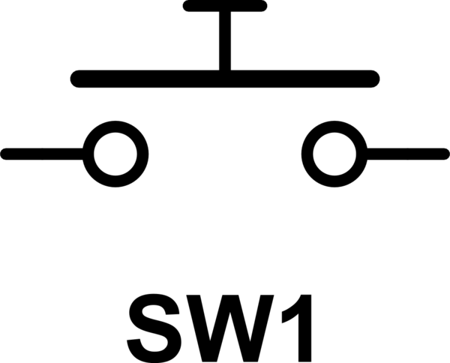
Button as a Switch

Slide 26
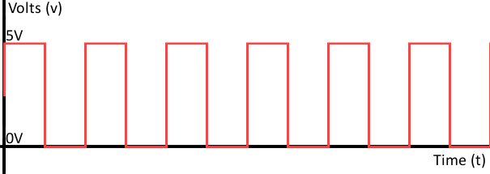
Project 3 - Let’s ’Read’ Something
The Arduino can ‘drive’ pins
The Arduino can also ‘read’ pins
Allows Arduino to ’read’ sensors, collect data, etc.
Need to program the Arduino to make it ‘smart’
The Arduino can set pins to HIGH or LOW
The Arduino can read pins as either HIGH or LOW

Slide 27
Project 3 Parts List
Arduino
Breadboard
USB Cable
1 DHT11 Humidity / Temperature Sensor
3 Male-Male wires

Slide 28
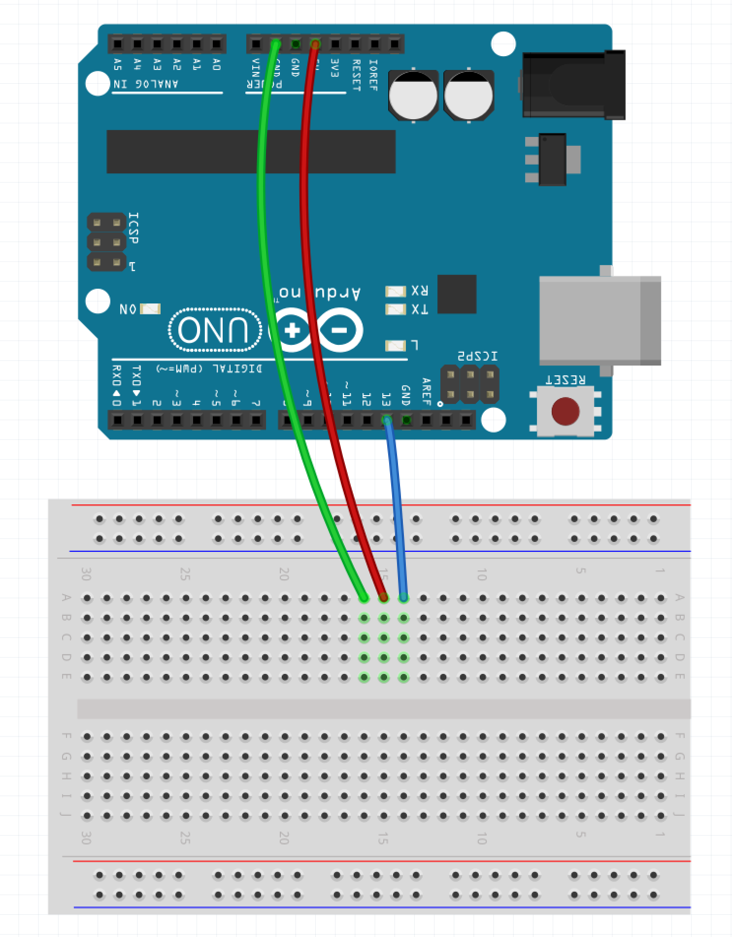
Step 1 - Wiring
Make sure the USB Cable is not plugged into the PC
Place a wire (green in example) from GND on the Arduino to A:16 on the board
Place a wire (red in example) from 5V on the Arduino to A:15 on the board
Place a wire (blue in example) from pin 13 on the Arduino to A:14 on the board
Place the DHT11 board directly into E:16, E:15, and E:14 so the blue part is facing away from the Arduino

Slide 29
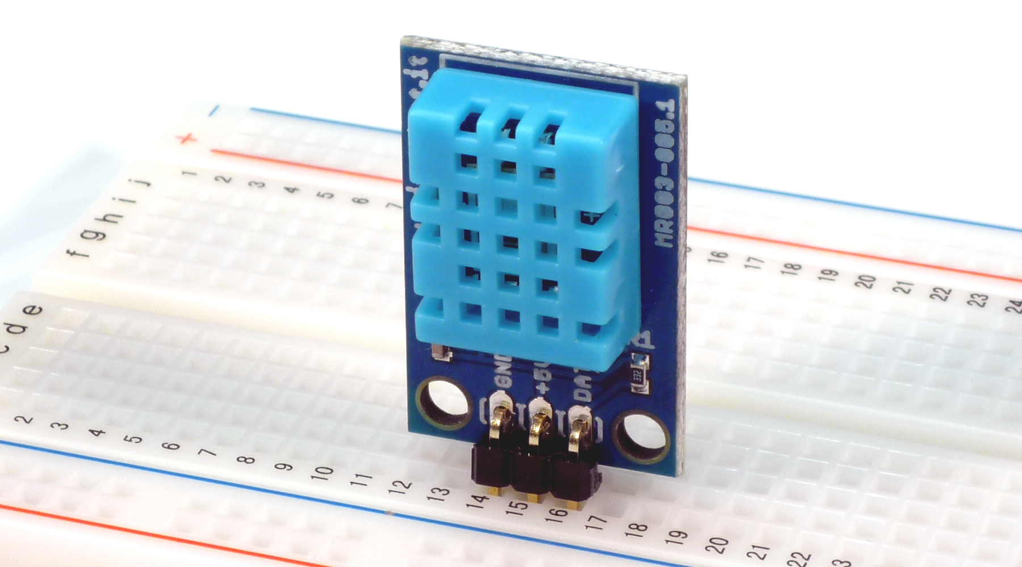
Step 2 – Part Placement
Place the DHT11 board directly into E:16, E:15, and E:14 so the blue part is facing away from the Arduino towards you – similar to the image below

Slide 30
Step 3 – Power the Arduino
Plug the Arduino into the USB Cable
Plug the USB Cable into the PC

Slide 31
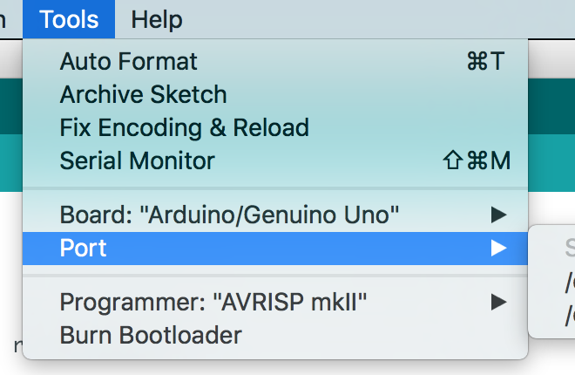
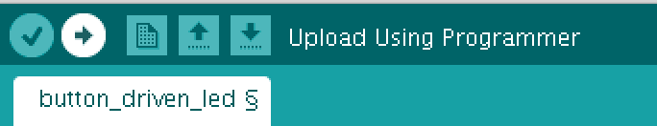
Step 4 – Program the Arduino
Plug the board into the PC via the USB plug
Open Sketch dht11.ino in the dht11_example directory/folder
Select Tools -> Port
Click the Upload Button

Slide 32
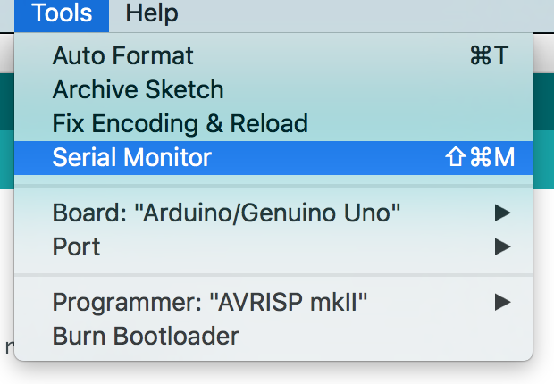
Step 5 – Open the Serial Monitor
Go to Tools and select ‘Serial Monitor’

Slide 33
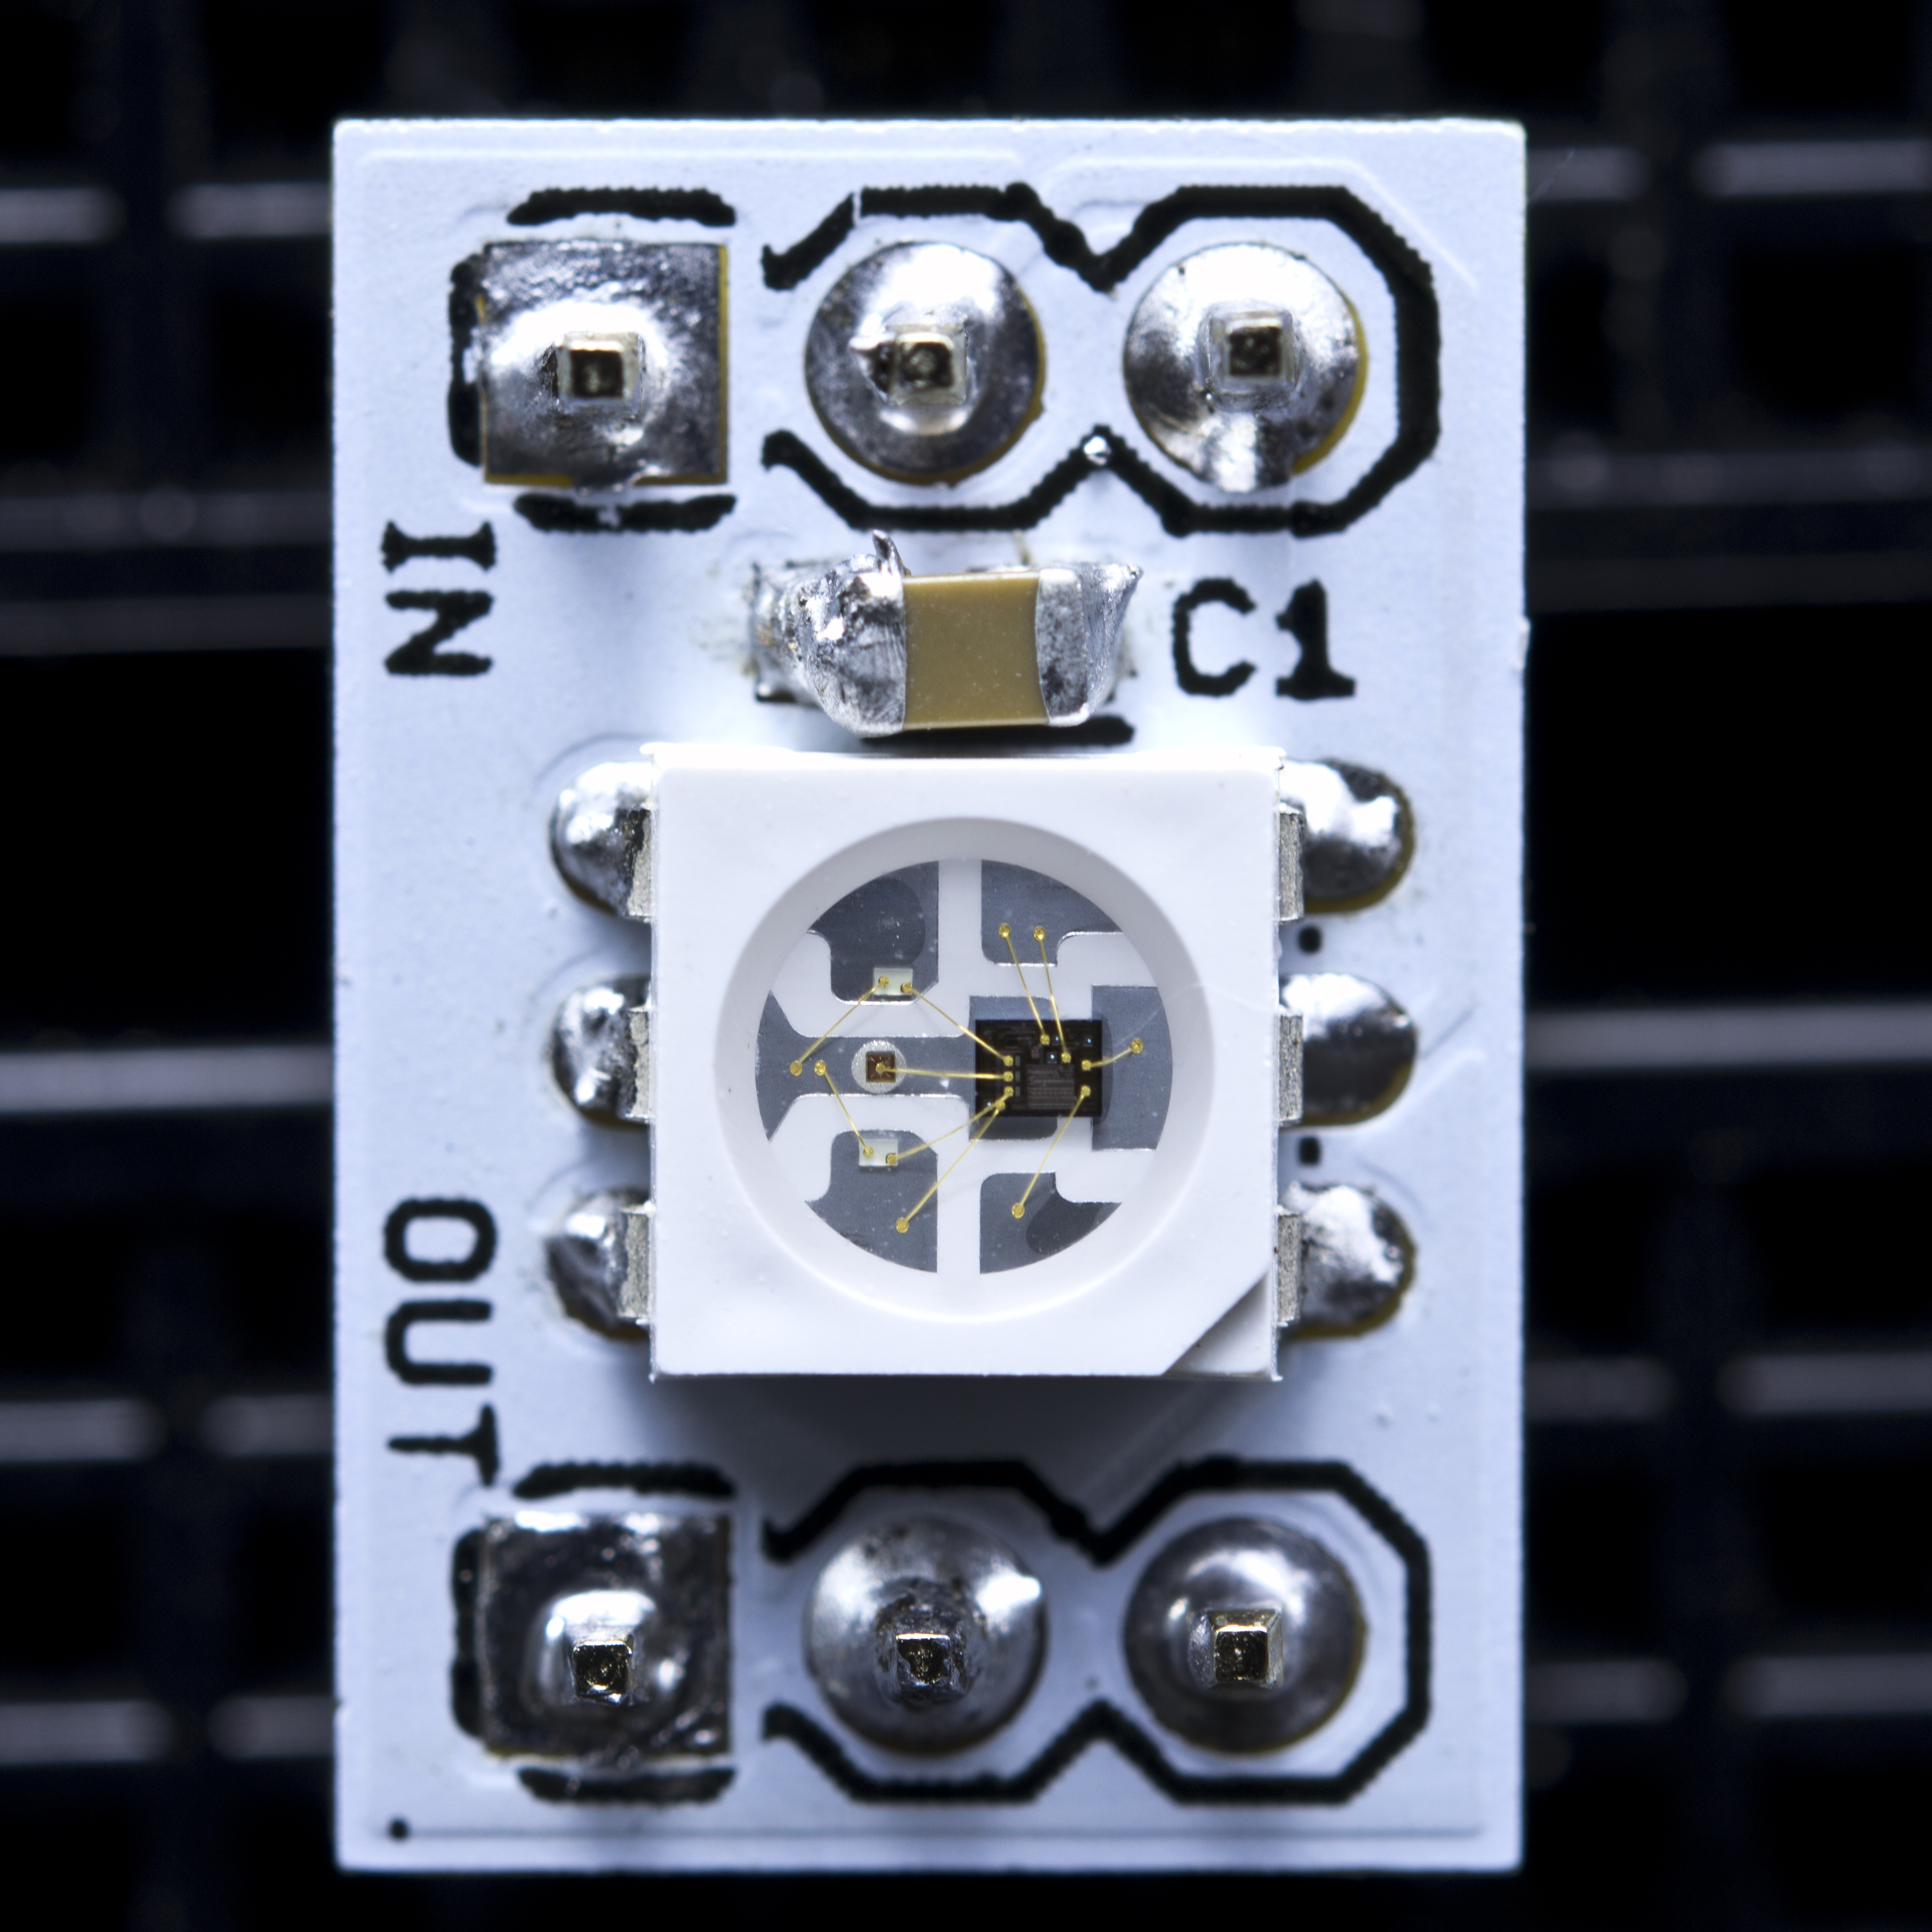
WS2811

Slide 34
Project 4 Parts List
Arduino
Breadboard
USB Cable
1 Neo Pixel Strip with 8 LEDs
1 1000F Capacitor
1 10K Ohm resistor
3 Male-Female wires
9 Male-Male wires
3 small buttons (not the bigger ones)

Slide 35
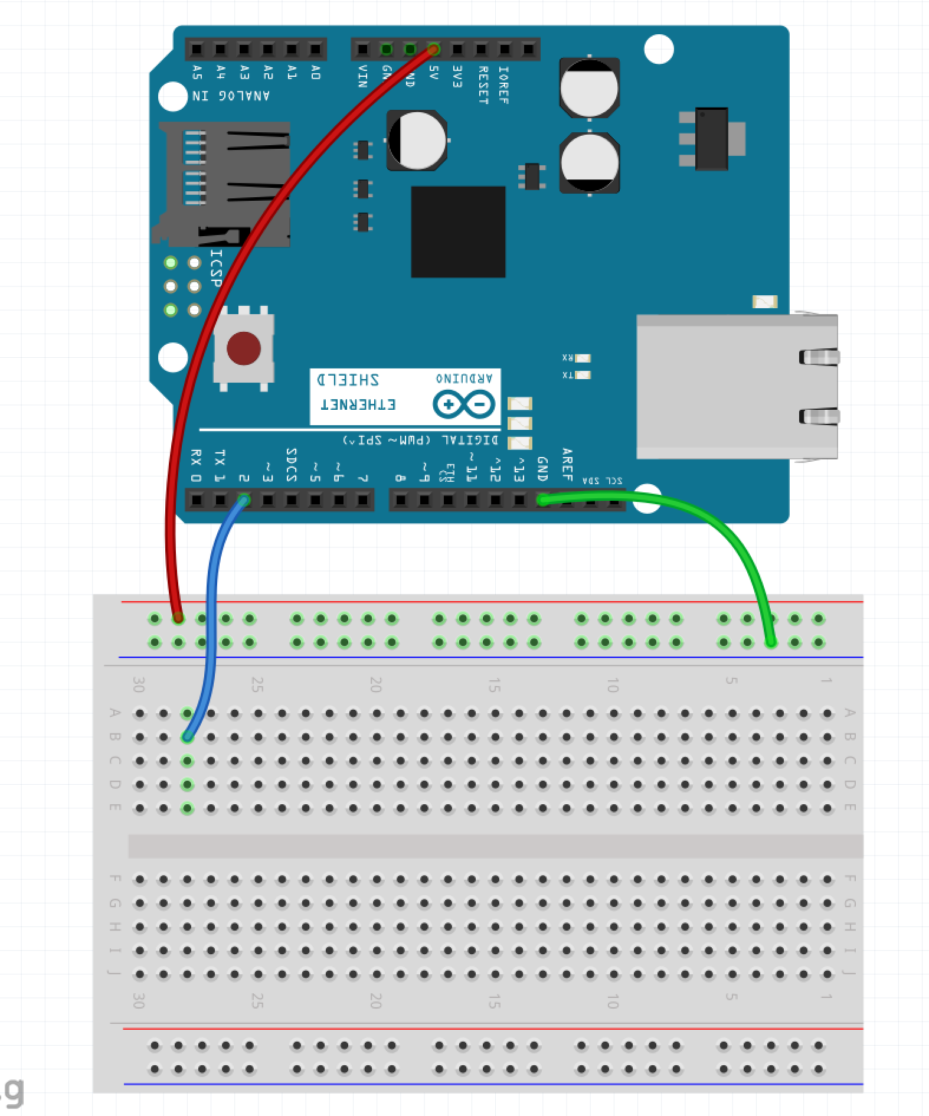
Step 1 – Wire the Rails
Make sure the USB Cable is not plugged into the PC
Run a wire from GND pin on Arduino to blue row on breadboard (green wire in example)
Run a wire from 5V pin on Arduino to red row on breadboard (red wire in example)
Run a wire from pin 2 of the Arduino to B:28 (blue wire in example)

Slide 36
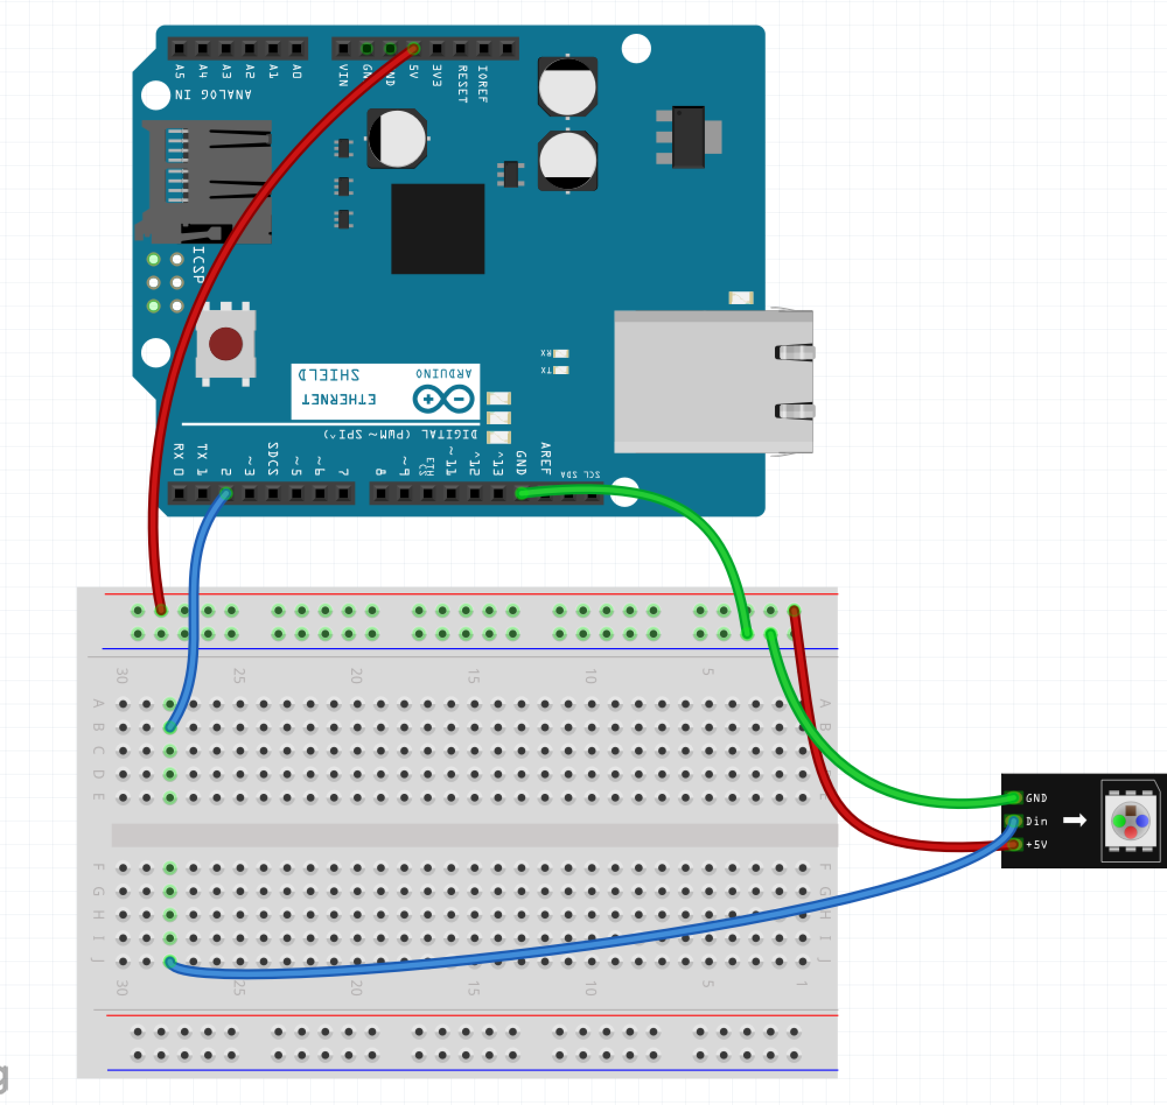
Step 2 – Wire the LED Strip
Run a wire from the Blue Row on breadboard to the GND pin of the LED strip (green wire in example)
Run a wire from the Red Row on breadboard to the 5V pin of the LED strip (red wire in example)
Run a wire from J:28 to the DIn pin of the LED strip (blue wire in example)

Slide 37
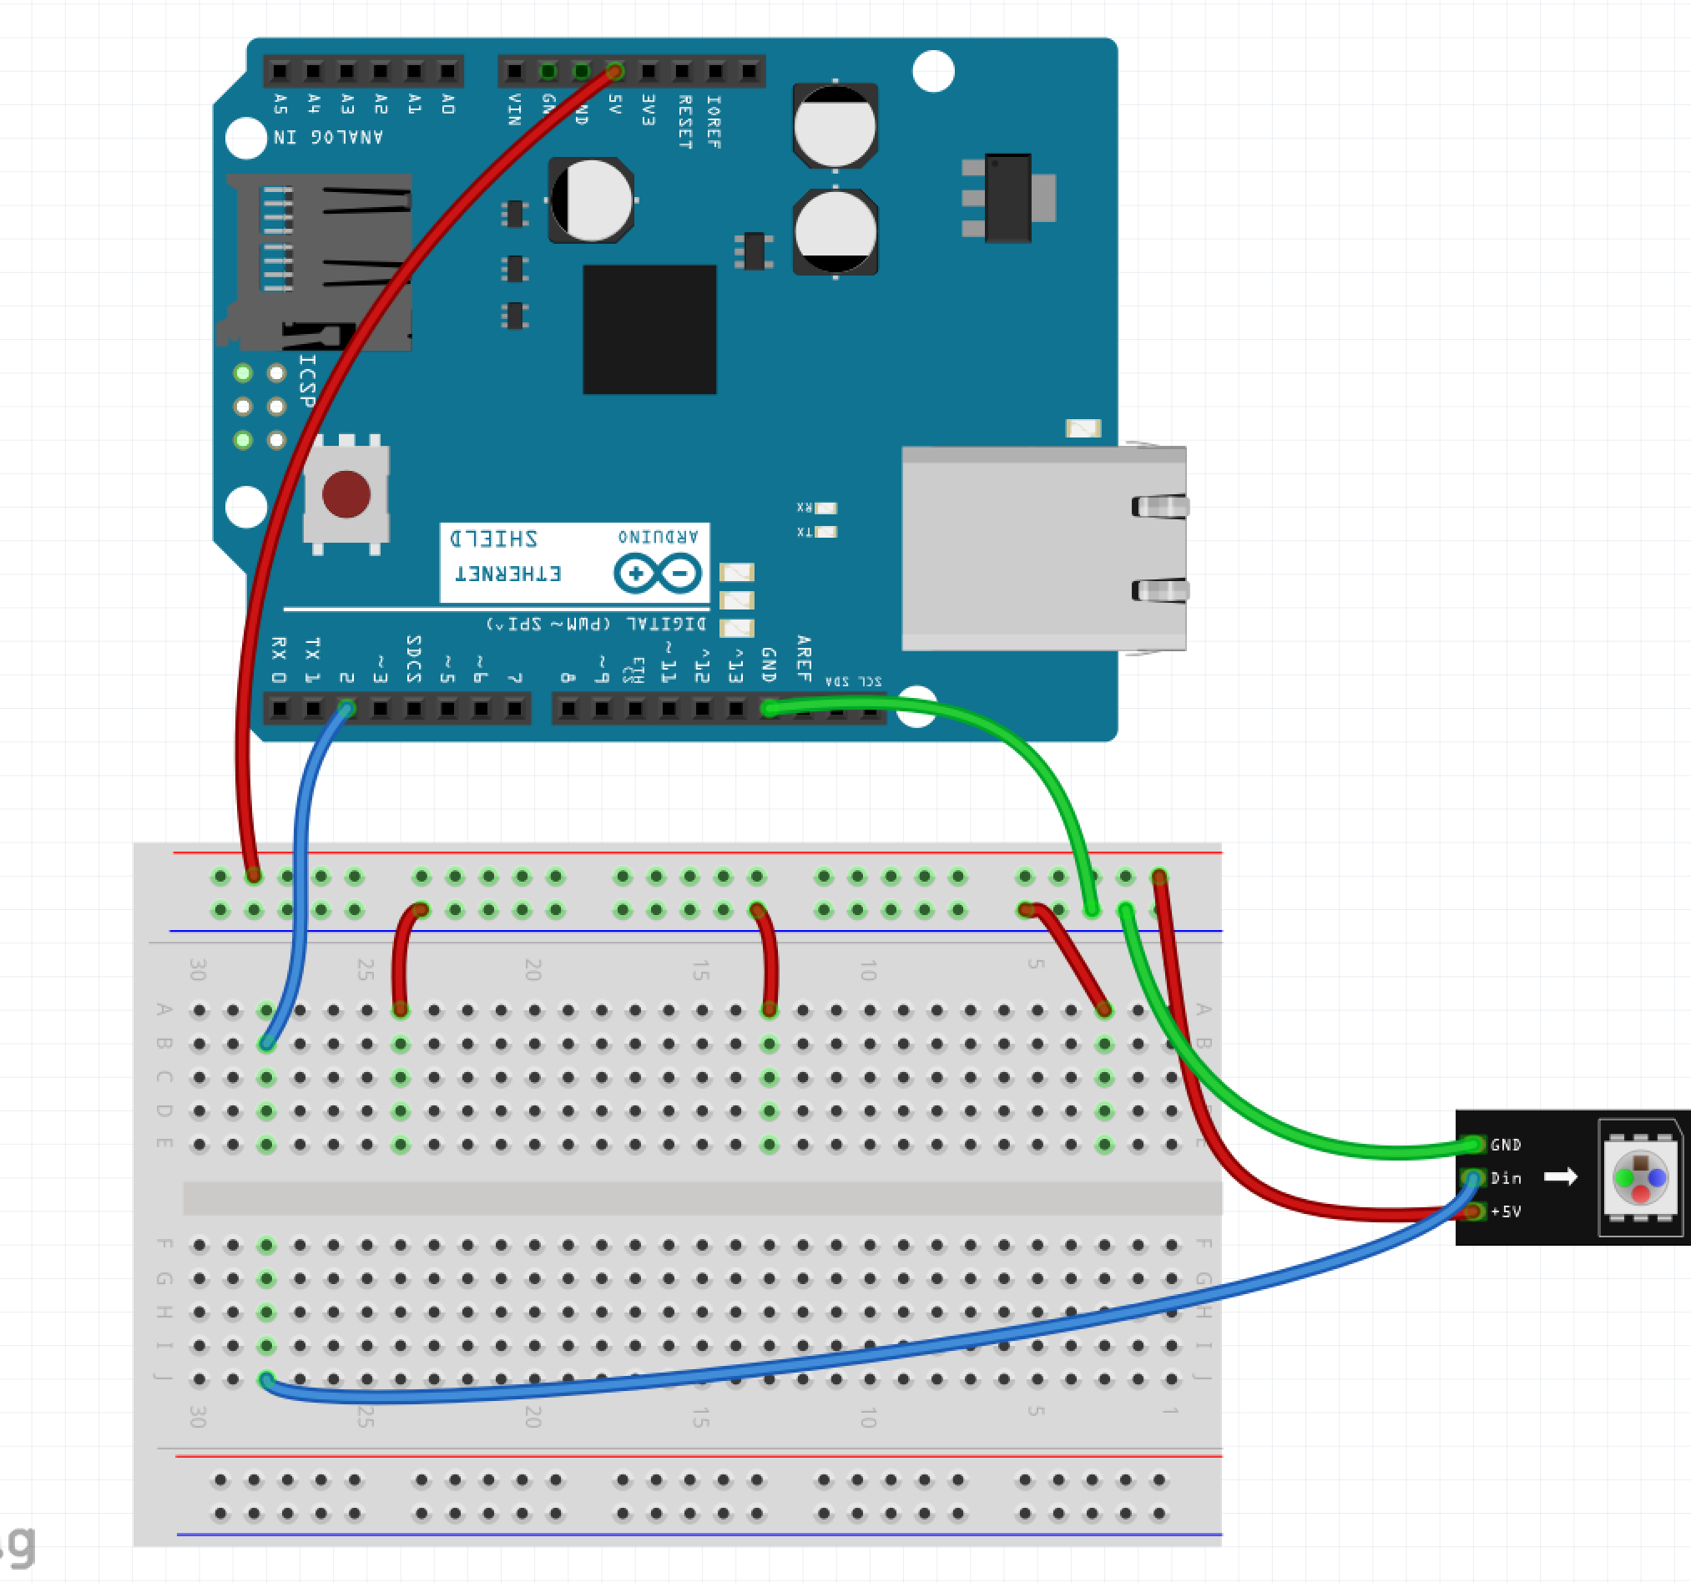
Step 3 – Wire One Side of Button
Run a wire from the Blue Row on breadboard to A:24
Run a wire from the Blue Row on breadboard to A:13
Run a wire from the Blue Row on breadboard to A:3

Slide 38

Step 4 – Wire Other Side of Button
Run a wire from pin 7 of the Arudino to A:22
Run a wire from pin 10 of the Arudino to A:15
Run a wire from pin 12 of the Arudino to A:5

Slide 39
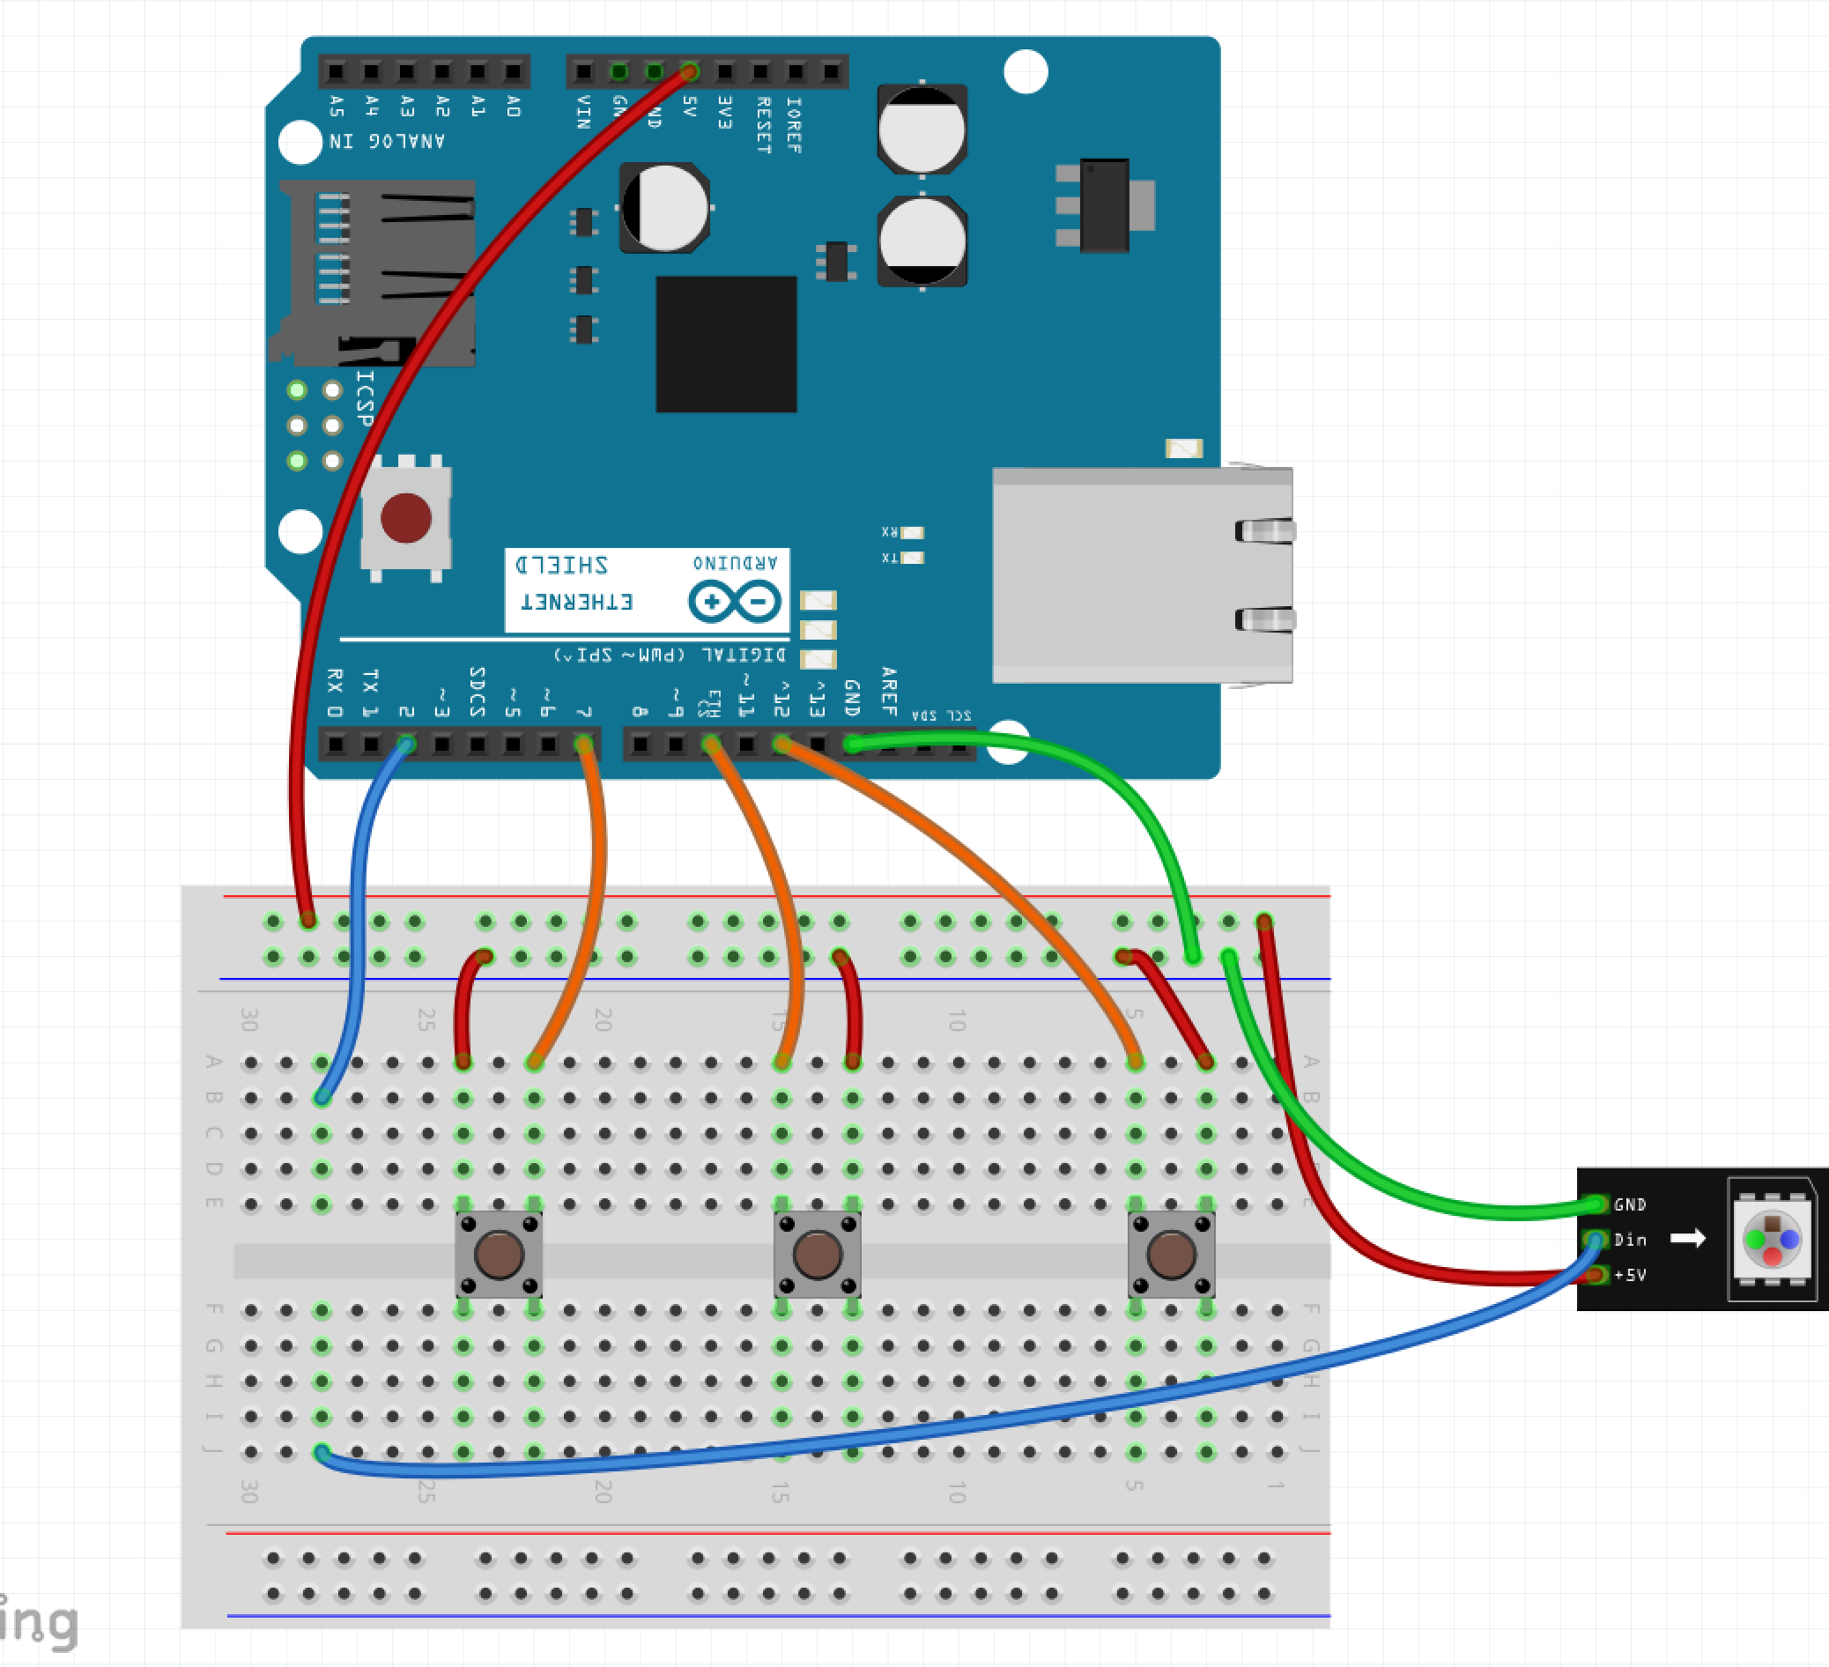
Step 5 – Button Placement
Place the 3 buttons across the gap
One in E:24 and E:22
One in E:15 and E:13
One in E:5 and E:3

Slide 40
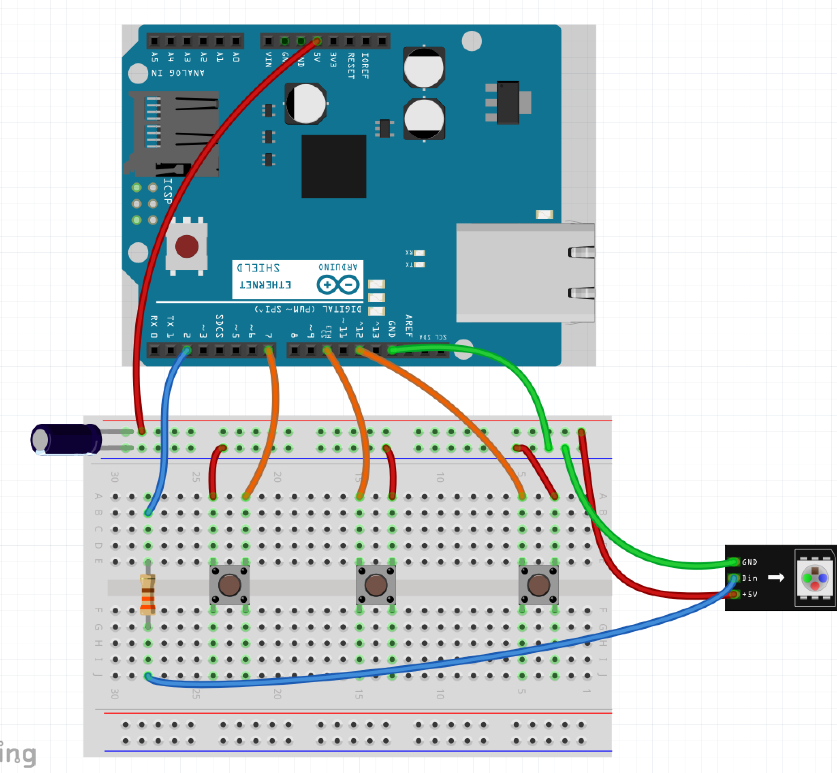
Step 6 – Components
Place the Resistor over the gap on E:28 and G:28
Place the capacitor with the long leg in the Red Row and the short leg in the Blue Row

Slide 41
Step 7 – Power the Arduino
Plug the Arduino into the USB Cable
Plug the USB Cable into the PC

Slide 42
Step 8 – Program the Arduino
Open Sketch button_driven_led.ino in the button_drive_led directory/folder
Select Tools -> Port
Click the Upload Button

Slide 43
What Next?
Guided Learning in Kits / Books
Online Tools
Spark Fun - https://www.sparkfun.com/
What you can do when you got it all down: https://youtu.be/ahpPqD7Ju5w?t=17s

